Slide 1
Adapting the Rete-Algorithm to Evaluate F-Logic Rules
Florian Schmedding
Nour Sawas
Georg Lausen
Databases and Information Systems Research Group
Albert-Ludwigs-University Freiburg

Slide 2
Overview
Motivation
F-Logic
The Rete-Algorithm
Benchmarks
Results
Conclusions

Slide 3
Motivation
In deductive databases rules are used to derive new facts from known data.
These rules may contain redundancies, like p(X) :- a(X,Y), b(X), c(Y). q(X) :- a(X,Y), b(X), d(Y,Z).
To reduce redundant deriving of facts, the Rete-Algorithm is used in production rule systems
But: How about its performace when it deals with few rules and a lot of data?

Slide 4
F-logic
Declarative language
Combines deductive databases with object-orientation
First-order semantics, but can express sets and class hierarchy
Covers Datalog
Our implementation is ‘Florid‘
it has bottom-up fixpoint semantics
and seminaive evaluation of predicates
Notes:
inheritance is a problem with seminaive evaluation or magic sets
because facts can be triggered after evaluation of the model

Slide 5
The Rete-Algorithm
was developed by Ch. Forgy in 1974 for production rule systems
its target is to identify common subgoals in rule bodies
this is done by constructing a network over all subgoals
which in turn is used to share matches in different rules
‘Rete’ is the Latin word for net

Slide 6
Simplified example
p(X,Y)
q(Y,_)
p(X,Y)
p(Y,Z)
q(Z,_)
a,b
c,b
b,e
pq(Y,Z)
pq(V₁,V₂,V₃)
a,b
c,b
b,e
r(X,Y)
s(X,Z)
b,e
c,e
Program:
p(a,b).
p(c,b).
p(d,e).
q(b,f).
q(e,g).
r(X,Y) :- p(X,Y), q(Y,_).
s(X,Z) :- p(X,Y), p(Y,Z), q(Z,_).
Notes:
this is an naive computation, uninformed

Slide 7
Rete network for: grandParentOf(X,Y) :- border(X,Z), border(Z,Y).
CTN
α-dummy
CTN
border
alpha part
β-memory
β-dummy
α-memory
Working Memory
JN
no test
beta part
β-memory
CTN: contant test node
JN: join node
PN: production node
WME: working mem. el.
JN
WME
PN

Slide 8
Adaption to F-Logic
In Florid, we want to compute all results
Immediate effects of new facts are not considered
Therefore we compute all new facts before passing them down in the network (similar to stratification)
Make use of index structures
Re-use production nodes as beta memories

Slide 9
Benchmarks
To compare rete with semi-naive evaluation, we wrote a non-recursive test program
in a short optimized version, e.g. grandParentOf(X,Y) :- border(X,Z), border(Z,Y). grandGrandParentOf(X,Y) :- grandParentOf(X,Z), border(Z,Y).
and in a long version with redundancies, e.g. grandParentOf(X,Y) :- border(X,Z), border(Z,Y). grandGrandParentOf(X,Y) :- border(X,Z), border(Z,U), border(U,Y).
As input we used increasing numbers of the predicate border/2.

Slide 10
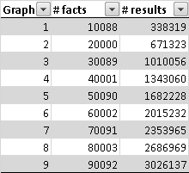
Input EDB
We extended the data by duplicating the base graph and built a “binary-tree-style” structure by connecting with the blue arrows.
We repeated this procedure to create data sets of increasing depth:

Slide 11
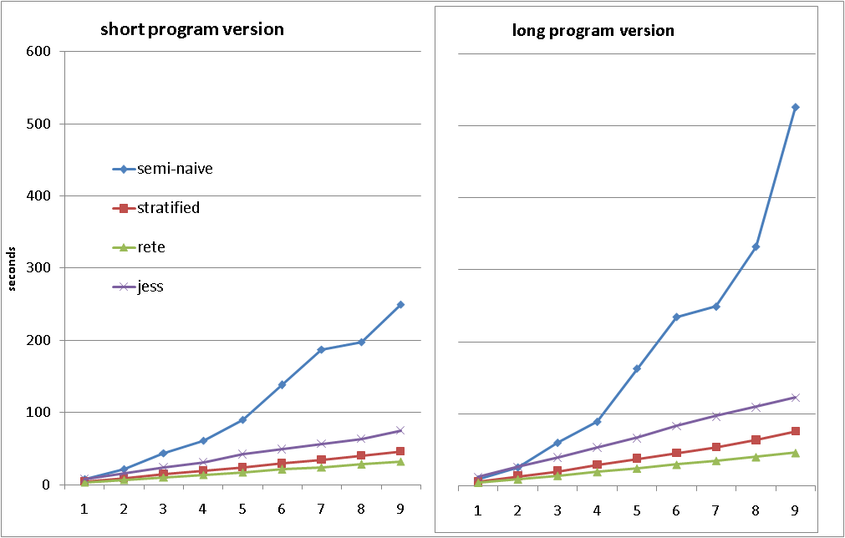
Results

Slide 12
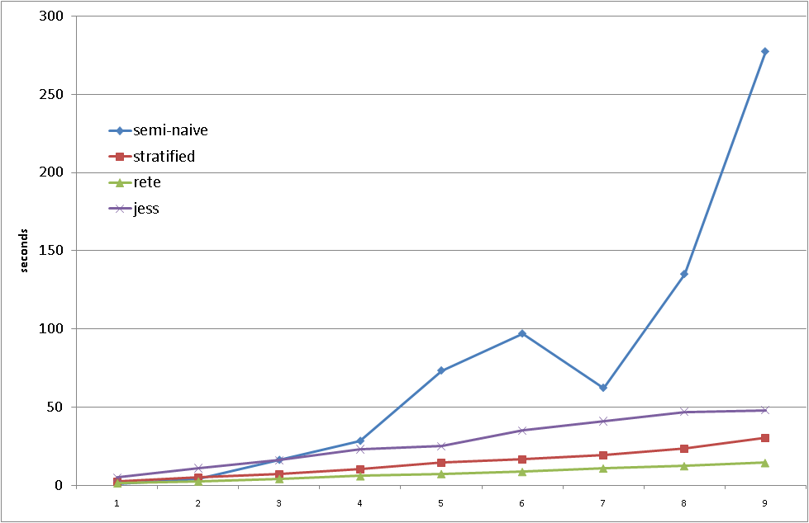
Time differences between the two versions:

Slide 13
Conclusions
Rete seems to be a considerable improvement in our test cases
Our implementation had the smallest difference between the optimized and the redundant version, so it made effective re-use of computed results
There was no drawback with increased EDBs
So Rete is applicable to deductive databases
We have to investigate it with recursive programs
Extend Rete to full F-logic

Slide 14
Thanks for your attention!

Slide 15
Literature
Rete: A Fast Algorithm for the Many Pattern/Many Object Pattern Match Problem. Charles L. Forgy. Artificial Intelligence 19, 1982
Production Matching for Large Learning Systems. Robert B. Doorenbos. PhD thesis, 1995
How to Write F-Logic Programs in FLORID. Wolfgang May, Pedro José Marrón, 1999
Florid User Manual. Wolfgang May, 2000

Slide 16
Florid example Separating countries in island and midlands
borders(de,fr). encompasses(fr,europe).
encompasses(de,europe). encompasses(is,europe).
X:midland :- borders(X,_).
X:midland :- borders(_,X).
?- sys.strat.doIt.
X:island(Y) :- encompasses(X,Y), not X:midland.
?- sys.eval.
?- X:island(Y).
% Answer to query : ?- X:island(Y).
is:island(europe).

Slide 17
Implementation in Florid
Copy to re-use
β-memory hash table
β-memory hash table
α-memory
α-memory
Working Memory
Predicates ---------- F-Atoms
α-memory
hash table
different α-memory
hash table
α-memory
hash table
JN
JN
JN
β-memory hash table
Copy to re-use
WME
β-memory hash table
PN
[…]

Slide 18
Short program version
parentOf(X,Y) :- border(X,Y).
childOf(X,Y) :- border(Y,X).
grandParentOf(X,Y) :- border(X,Z), border(Z,Y).
grandChildOf(X,Y) :- border(Y,Z), border(Z,X).
grandGrandParentOf(X,Y) :- grandParentOf(X,Z), border(Z,Y).
grandGrandChildOf(X,Y) :- grandChildOf(X,Z), border(Y,Z).
grandGrandGrandParentOf(X,Y) :- grandParentOf(X,Z), grandParentOf(Z,Y).
grandGrandGrandChildOf(X,Y) :- grandChildOf(X,Z), grandChildOf(Z,Y).
sibling(X,Y) :- border(Z,X), border(Z,Y).
spouse(X,Y) :- border(X,Z), border(Y,Z).
uncleOf(X,Y) :- border(Z,X), grandParentOf(Z,Y).
greatUncleOf(X,Y) :- grandGrandParentOf(W,Y), grandParentOf(W,X).
niceOf(X,Y) :- border(Z,Y), grandParentOf(Z,X).
cousin(X,Y) :- grandParentOf(U,X), grandParentOf(U,Y).

Slide 19
Long program version
parentOf(X,Y) :- border(X,Y).
childOf(X,Y) :- border(Y,X).
grandParentOf(X,Y) :- border(X,Z), border(Z,Y).
grandChildOf(X,Y) :- border(Y,Z), border(Z,X).
grandGrandParentOf(X,Y) :- border(X,Z), border(Z,U), border(U,Y).
grandGrandChildOf(X,Y) :- border(Y,Z), border(Z,U), border(U,X).
grandGrandGrandParentOf(X,Y) :- border(X,Z), border(Z,U), border(U,V), border(V,Y).
grandGrandGrandChildOf(X,Y) :- border(Y,Z), border(Z,U), border(U,V), border(V,X).
sibling(X,Y) :- border(Z,X), border(Z,Y).
spouse(X,Y) :- border(X,Z), border(Y,Z).
uncleOf(X,Y) :- border(Z,X), border(Z,U), border(U,Y).
greatUncleOf(X,Y) :- border(W,U), border(W,V), border(U,Z), border(Z,Y), border(V,X).
niceOf(X,Y) :- border(Z,Y), border(Z,W), border(W,X).
cousin(X,Y) :- border(V,X), border(U,V), border(U,W), border(W,Y).

